Slide 1

Data Analysis/ Future predictions based on Farmers Dataset
Group Members
Muhammad Ahsan [20SW106]
Junaid Aslam (G.L) [20SW084]
Agha Durrez Khan [20SW075]

Slide 2

Agriculture's Significance in Pakistan:
Backbone of Pakistan's economy
Contributes approximately 24% to GDP
Direct or indirect dependence of the majority of the population

Slide 3

Challenges in Agriculture Sector:
Inefficiencies in management
Lack of coordination between landlords and farmers
Poor management of vast land tracts owned by landlords

Slide 4
Solution: "IntelliFarm" App
Comprehensive and unified farm management system
Developed using the Flutter framework
Aims to streamline farm management complexities

Slide 5

Objectives and Benefits:
Enhance communication, organization, and efficiency
Benefit landlords, tenants, and stakeholders
Key functionalities:
Tenant management
Expense tracking
Financial report generation
Seamless communication
Farmer screening/verification
Event tracking via integrated calendar

Slide 6
Main Purpose:
Simplify farm management
Utilize historical data for informed decision-making
Maximize farm productivity

Slide 7

The Role of Data Science in Farm Management
Data Science in Farm Management:
Data sources include crop yields, expenses, and profits.
Utilize data science for critical historical data analysis.
Aim to make well-informed decisions for productivity and profit maximization.
Generate reports and graphs for landlord decision support.
Enhance farm productivity through data-driven insights.
Illustrate data science's impact with example graphs in the app.

Slide 8
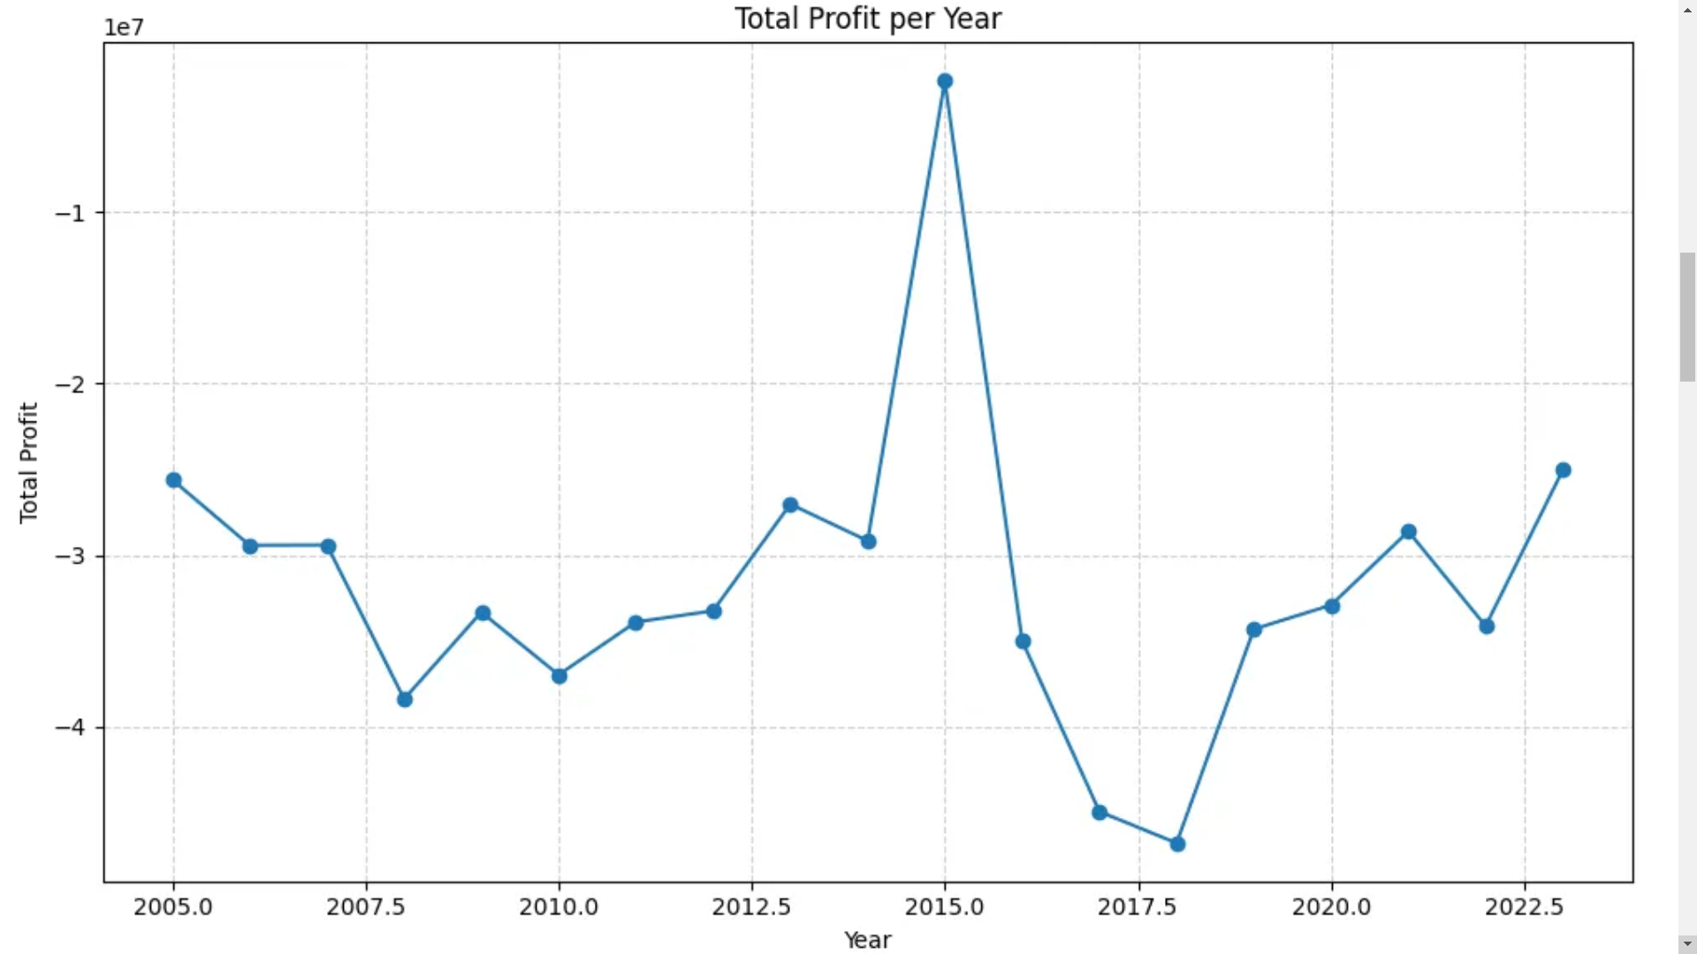
Notes:
In the above graph we can see the total profit per year of the farmland. This will inform the landlord on how effective his management has been throughout the years.

Slide 9
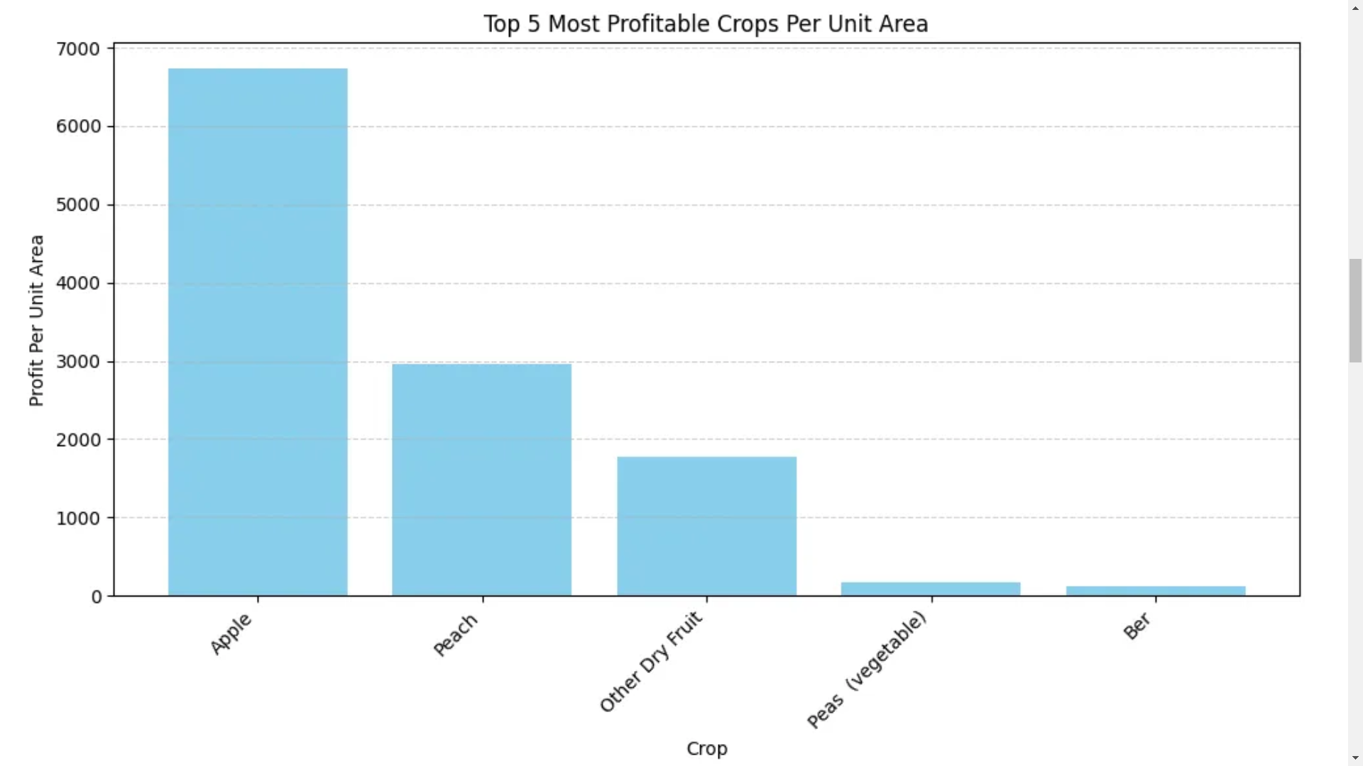
Notes:
The above graph shows the top 5 most profitable crops that are grown on the farmland. This can be used by a landlord to determine which crop he should focus on growing in order to maximize profit.

Slide 10
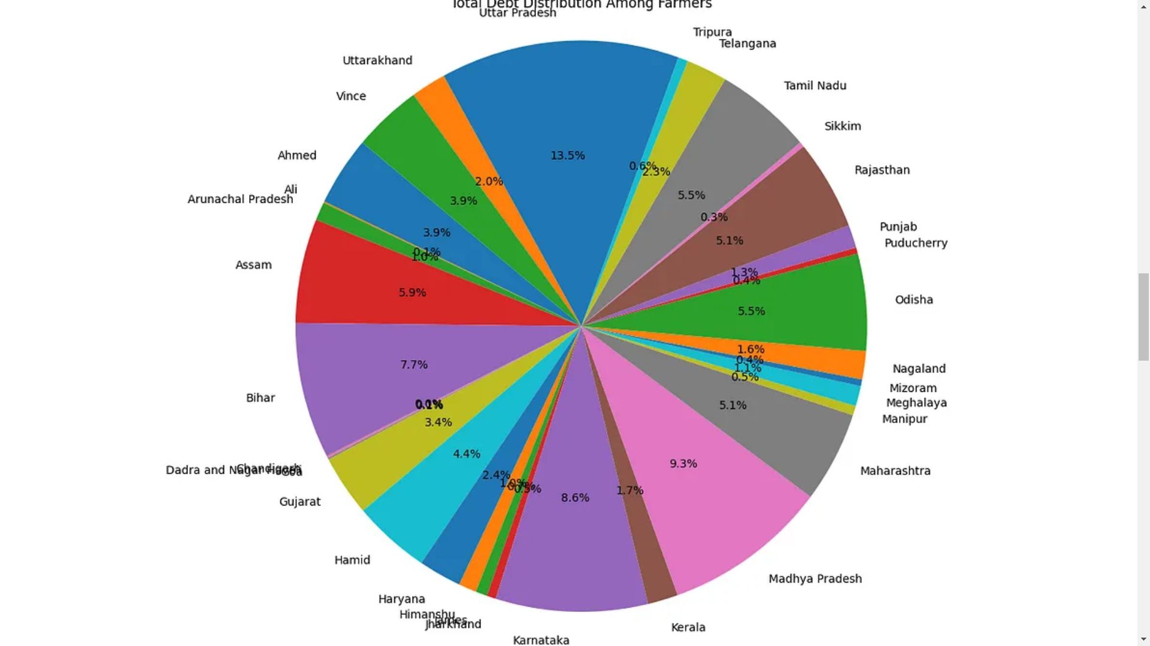
Notes:
In the above graph we can see the distribution of debt between the farmers. This will allow the landlord to determine which farmer can be entrusted with growing more crops.

Slide 11

Conclusion
Data Science's Vital Role:
Crucial for project success.
Provides invaluable insights.
Systematic data collection, analysis, and interpretation.
Empowers project functionality.
Essential for overall success.

Slide 12
Our CEP Project Dataset Link from Kaggle
https://www.kaggle.com/code/prasadkevin/crops-prediction-indian-dataset

